Slide 1
Learning Management System
By: Kyle Vessey, Brandon Popson, Nhat Nguyen, Joshua Reese and Hung Ngo
Using “Ruby on Rails”

Slide 2
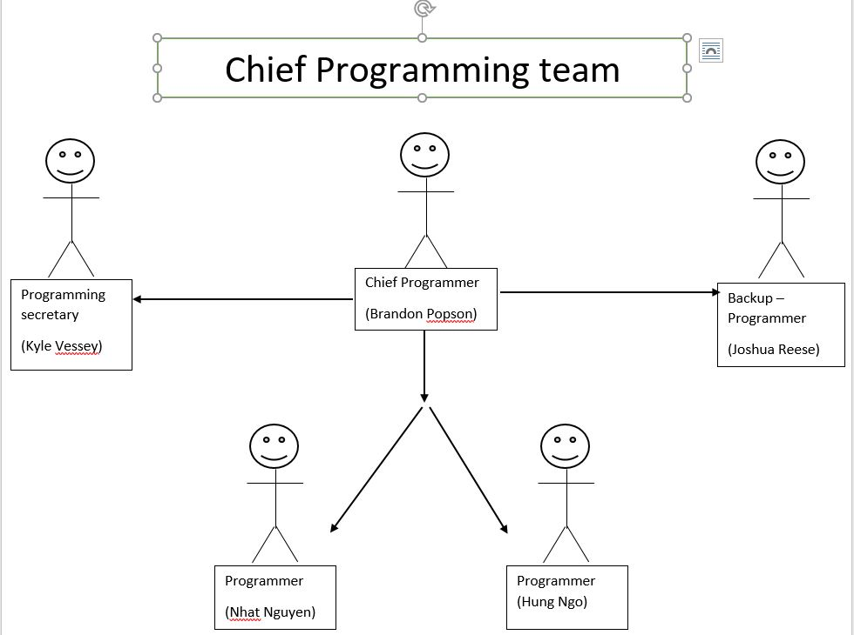
Team organization

Slide 3
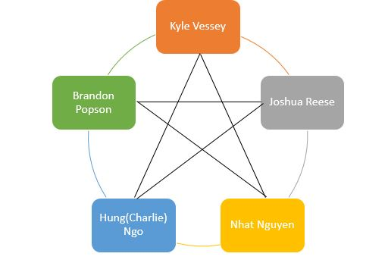
Team Model – (Democratic)

Slide 4
Iterative Life cycle
Testing
Verify
Design
Coding
Design
Verify
Design
Coding
Testing

Slide 5
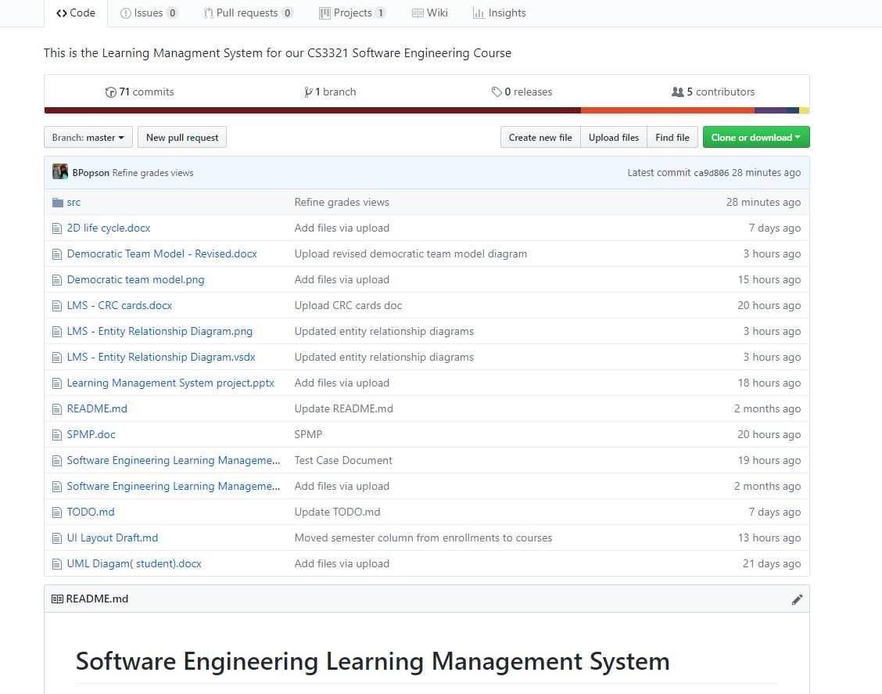
GitHub

Slide 6
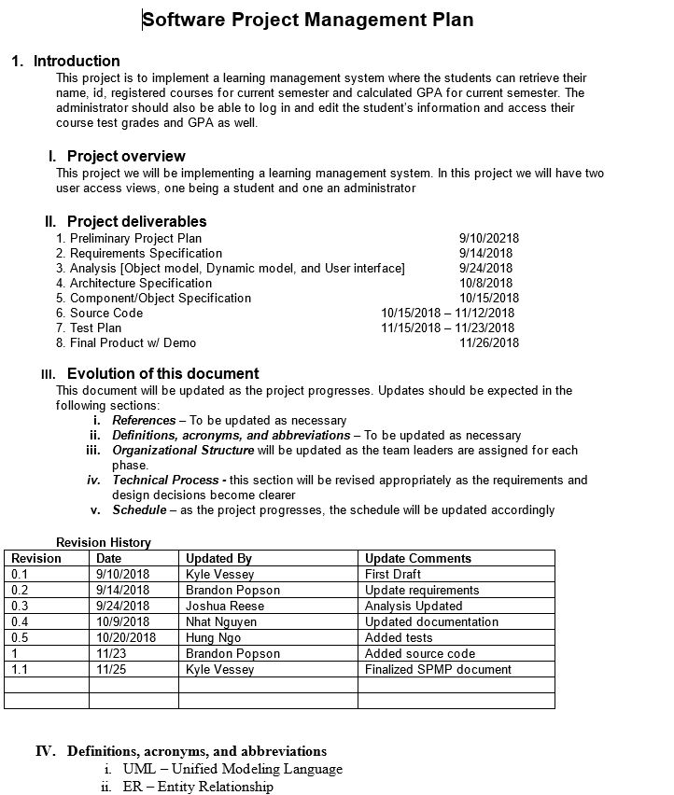
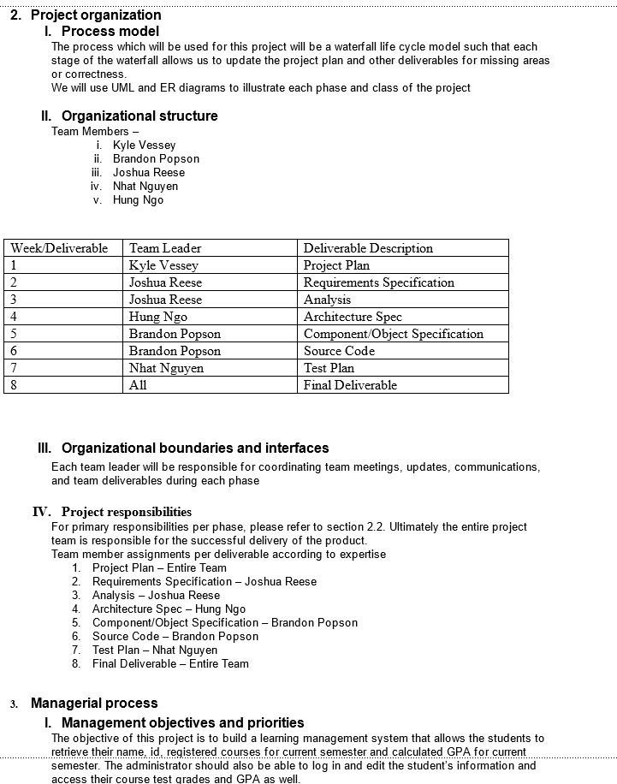
Software project management plan

Slide 7
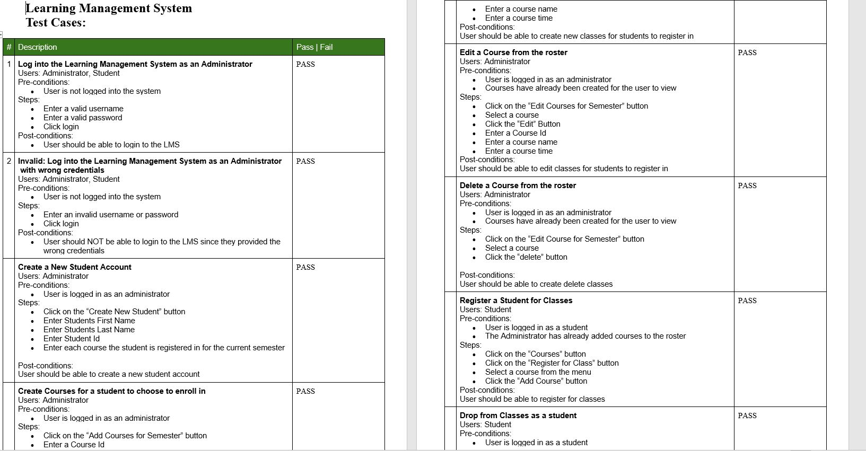
Test Case

Slide 8
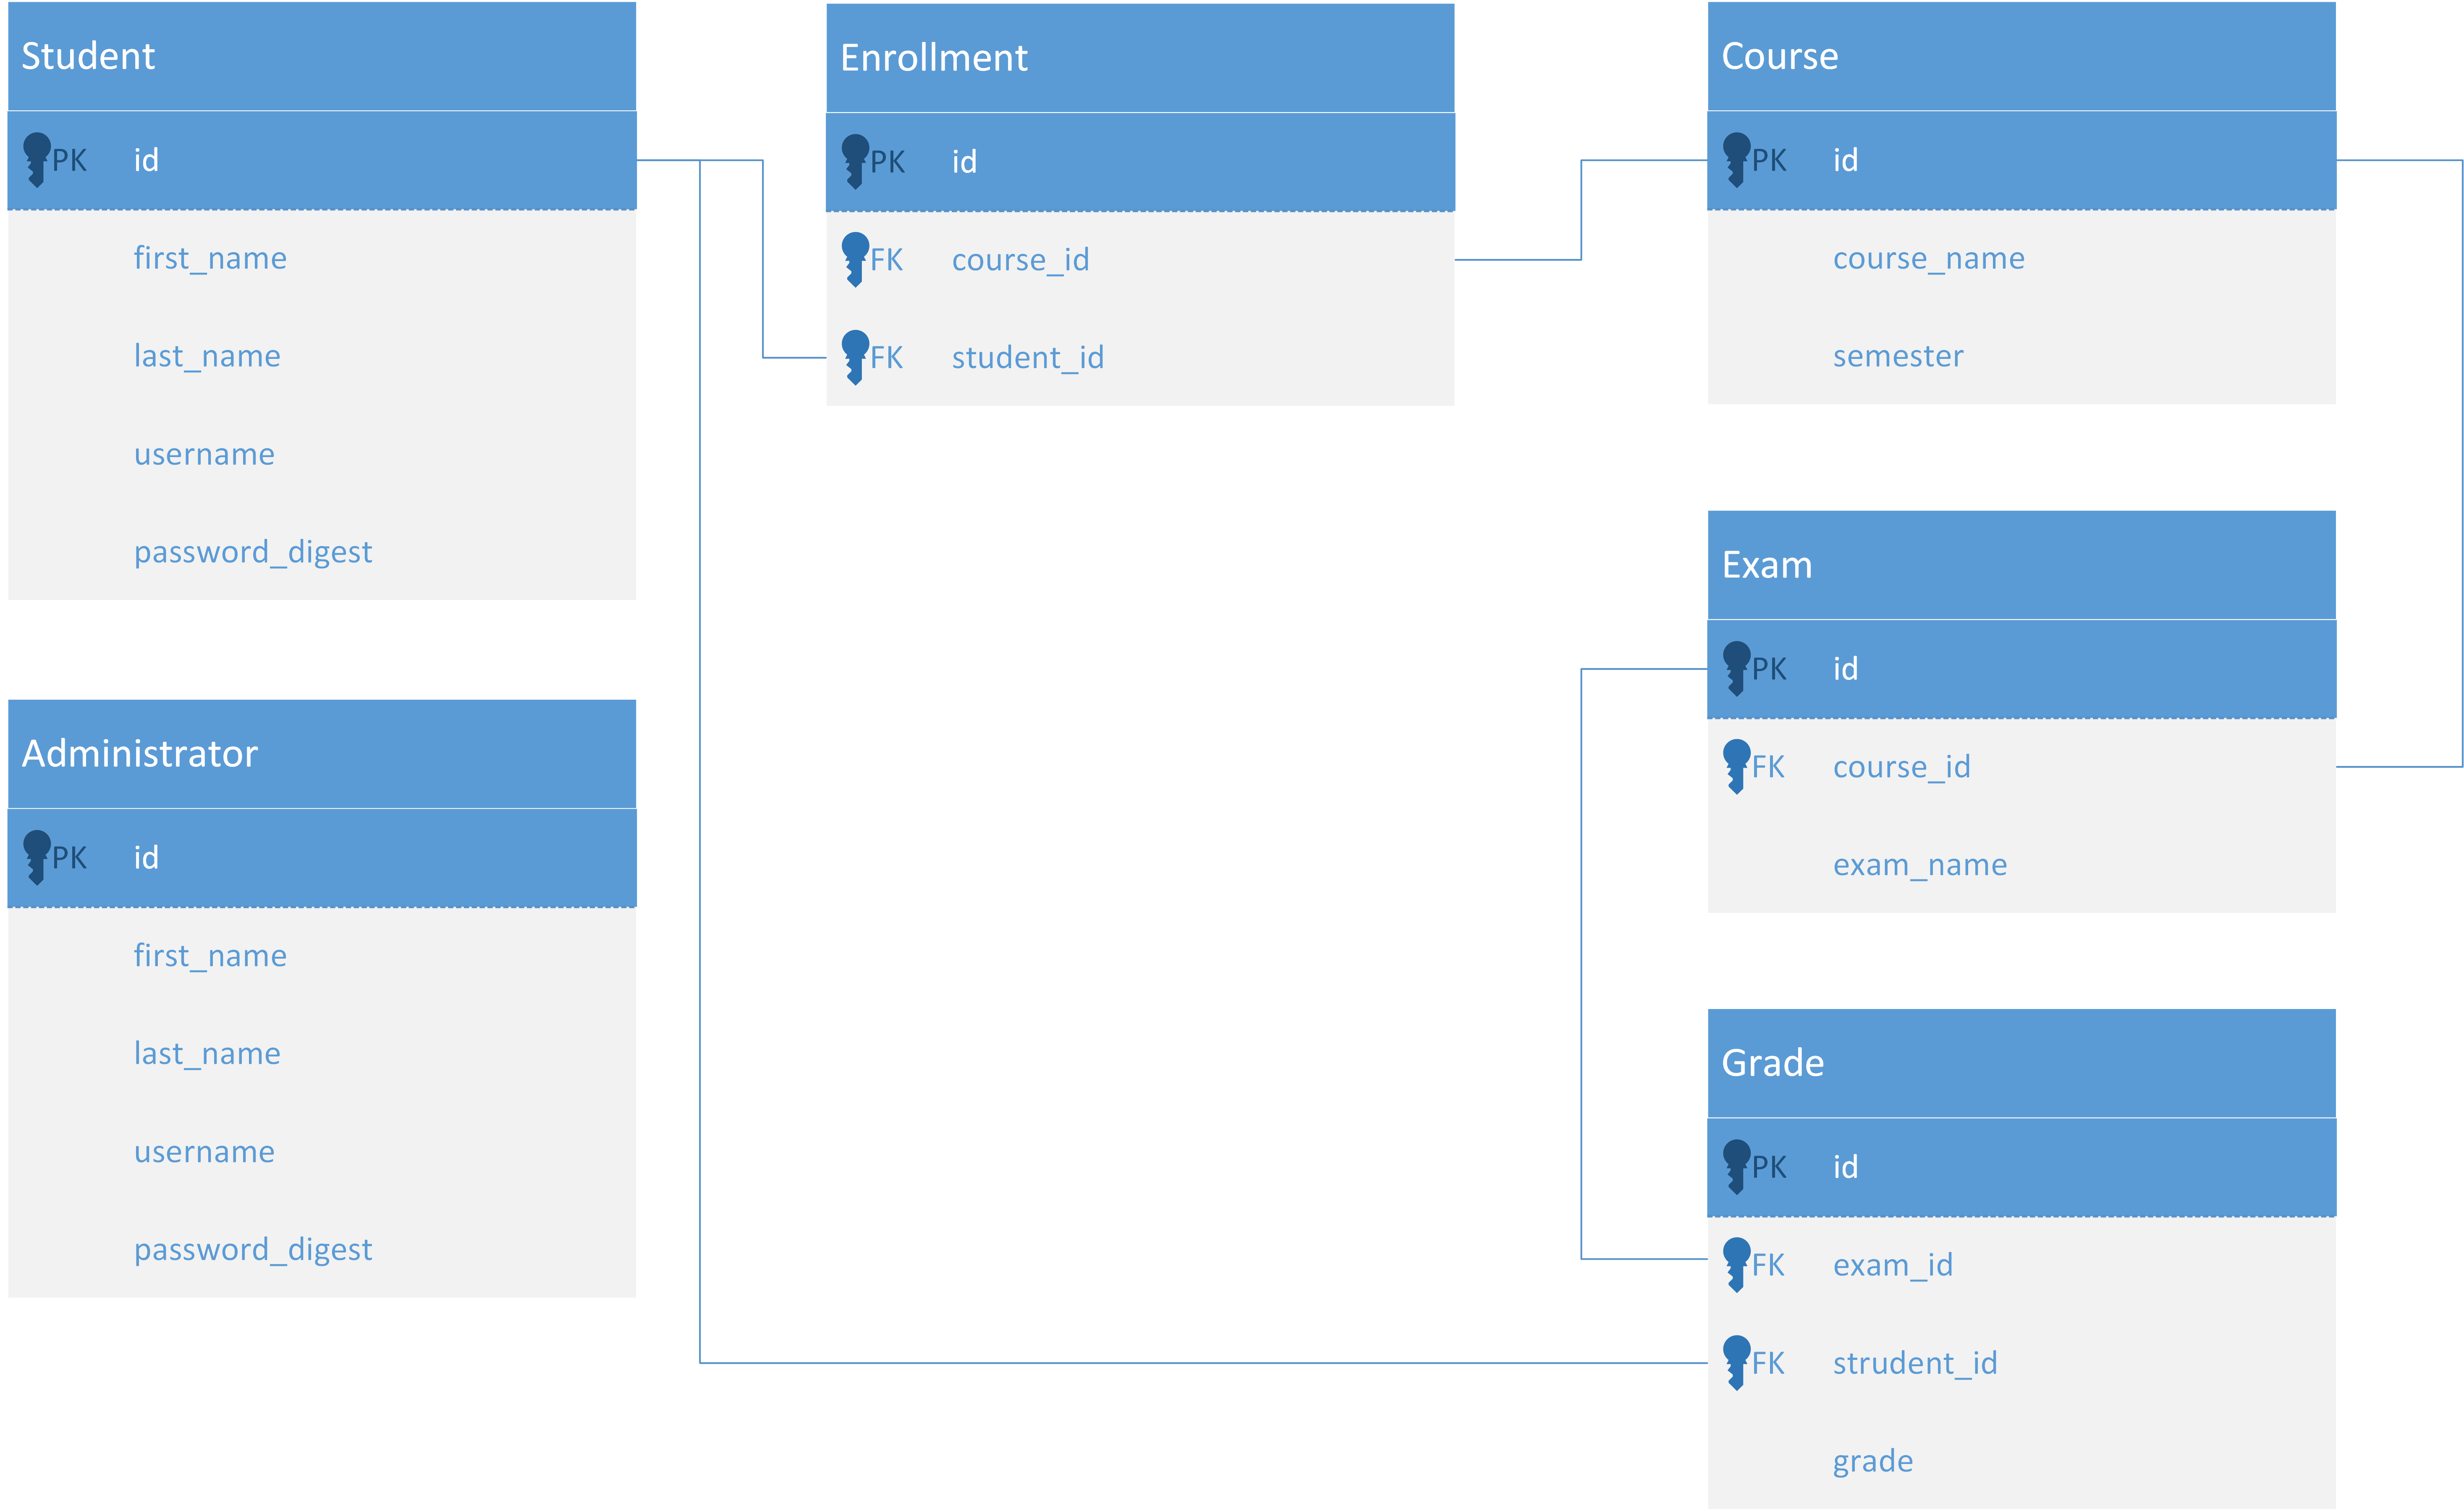
Relationship Diagram

Slide 9
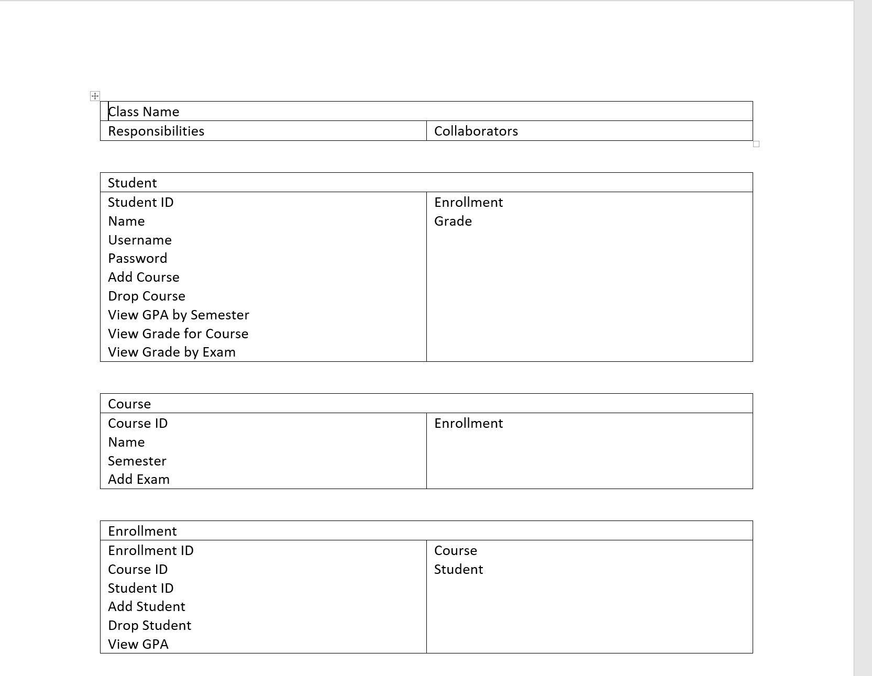
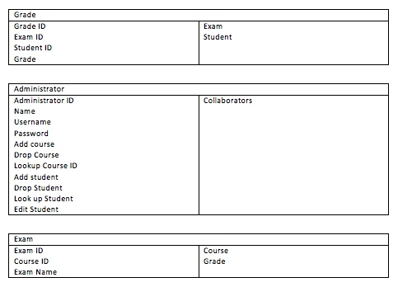
Class-responsibility-collaboration (CRC) cards

Slide 10
Fin

